Slide 1
We’re all going to die man! Modeling the transmission of a zombie apocalypse with the SIR model for spread of infectious disease.
Daisy Perez-Ruiz
Jason Phennicie

Slide 2
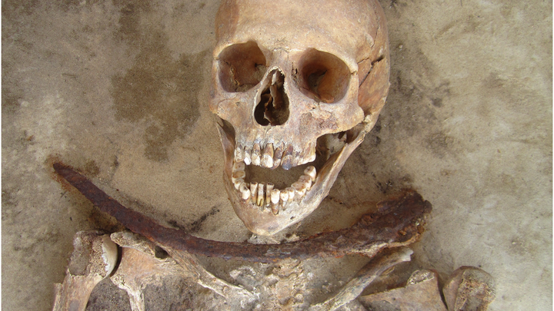
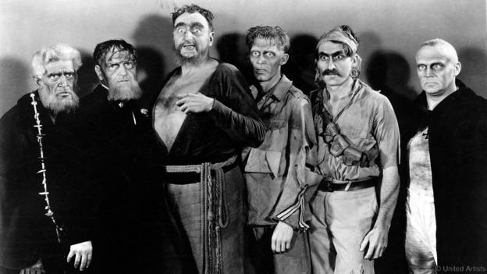
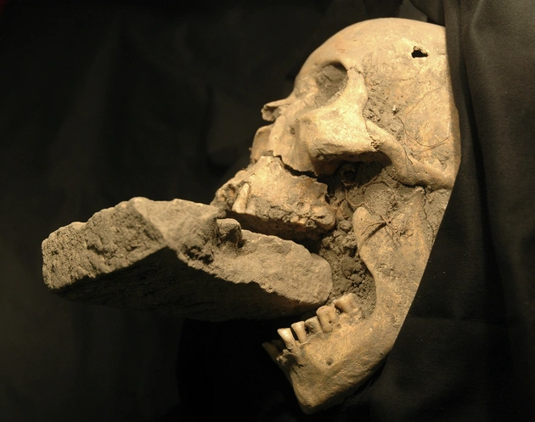
Zombie Apocalypse

Slide 3
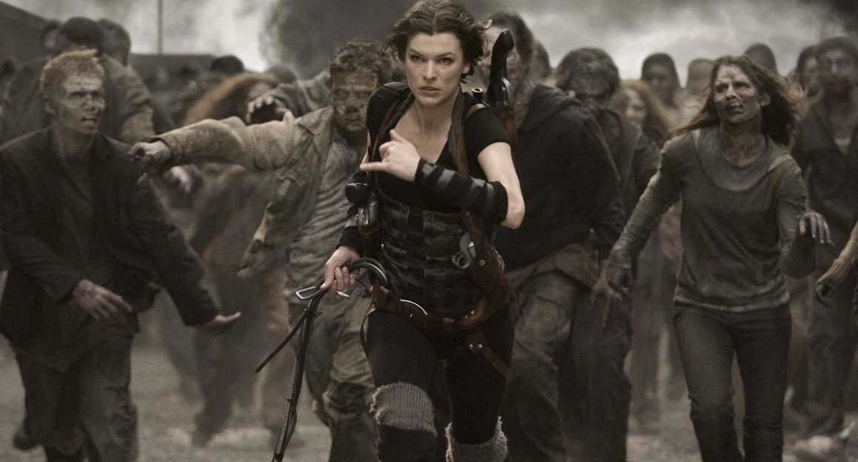


Zombie Apocalypse

Slide 4
Zombie Apocalypse
Simulated 5 different scenarios with different conditions to examine humanities survival outcomes.
Human
Effects of quarantine
Effects of extreme quarantine
Effects of increased zombie velocity
A counter attack by the remaining human force.

Slide 5
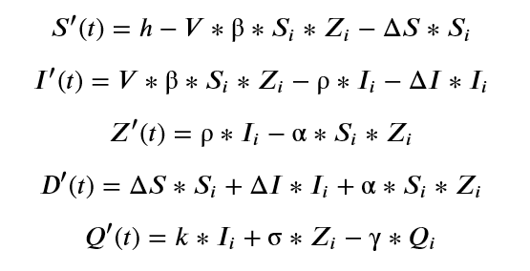
Modified SIR Model for Spread of Infectious Disease
𝑆𝑖 - Initial number of susceptible humans.
𝑍𝑖 - Initial number of zombies.
𝐼𝑖 - Initial number of infected humans.
𝐷𝑖 - Initial number of dead humans.
𝑄𝑖 - Initial number of quarantined humans.
𝑉 - Zombie to human velocity ratio.
ℎ - Increase in human population per unit time.
β - Probability of human being infected with the zombie virus per unit time.
ΔS - Probability of a human death per unit time.
Δ𝐼 - Probability of an infected human death per unit time.
ρ - Probability of infected human succumbing to zombie virus per unit time.
𝐺 - Probability of a dead human becoming a zombie per unit time.
𝑘 - Rate of infected human quarantine per unit time.
α - Probability of zombie death per unit time.
σ - Rate of zombie quarantine per unit time.
γ - Probability of human attempting to escape quarantine per unit time.

Slide 6
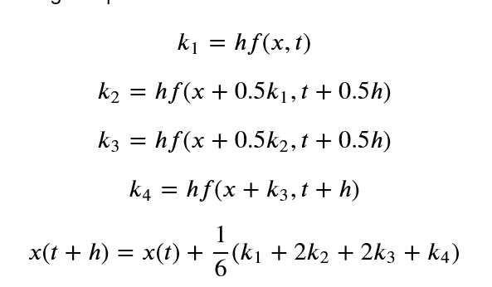
Numerical Methods
More accurate than Euler method
Fast
Relatively simple to code
Accurate to h⁴
h = (b-a)/N

Slide 7
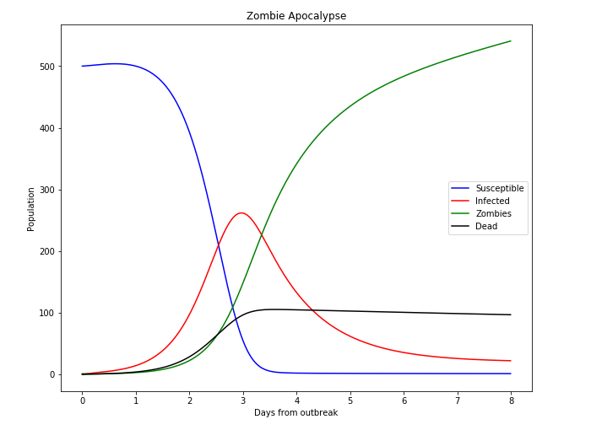
Results - Zombie Apocalypse
𝑆𝑖 - Initial number of susceptible humans.
𝑍𝑖 - Initial number of zombies.
𝐼𝑖 - Initial number of infected humans.
𝐷𝑖 - Initial number of dead humans.
𝑄𝑖 - Initial number of quarantined humans.
𝑉 - Zombie to human velocity ratio.
ℎ - Increase in human population per unit time.
β - Probability of human being infected with the zombie virus per unit time.
ΔS - Probability of a human death per unit time.
Δ𝐼 - Probability of an infected human death per unit time.
ρ - Probability of infected human succumbing to zombie virus per unit time.
𝐺 - Probability of a dead human becoming a zombie per unit time.
𝑘 - Rate of infected human quarantine per unit time.
α - Probability of zombie death per unit time.
σ - Rate of zombie quarantine per unit time.
γ - Probability of human attempting to escape quarantine per unit time.
h = 20
β = 0.03
ρ = 1
α = 0.006
ΔI = 0.0
ΔS = 0.0
G = 0.06
k = 0
σ = 0
γ = 0
V = 1
A

Slide 8
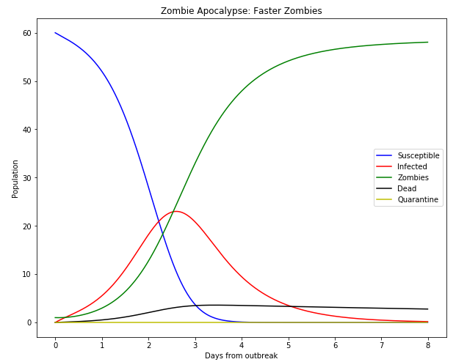
Results - Faster Zombies
𝑆𝑖 - Initial number of susceptible humans.
𝑍𝑖 - Initial number of zombies.
𝐼𝑖 - Initial number of infected humans.
𝐷𝑖 - Initial number of dead humans.
𝑄𝑖 - Initial number of quarantined humans.
𝑉 - Zombie to human velocity ratio.
ℎ - Increase in human population per unit time.
β - Probability of human being infected with the zombie virus per unit time.
ΔS - Probability of a human death per unit time.
Δ𝐼 - Probability of an infected human death per unit time.
ρ - Probability of infected human succumbing to zombie virus per unit time.
𝐺 - Probability of a dead human becoming a zombie per unit time.
𝑘 - Rate of infected human quarantine per unit time.
α - Probability of zombie death per unit time.
σ - Rate of zombie quarantine per unit time.
γ - Probability of human attempting to escape quarantine per unit time.
h = 0
β = 0.03
ρ = 1
α = 0.006
ΔI = 0.0
ΔS = 0.0
G = 0.06
k = 0
σ = 0
γ = 0
V = 3

Slide 9
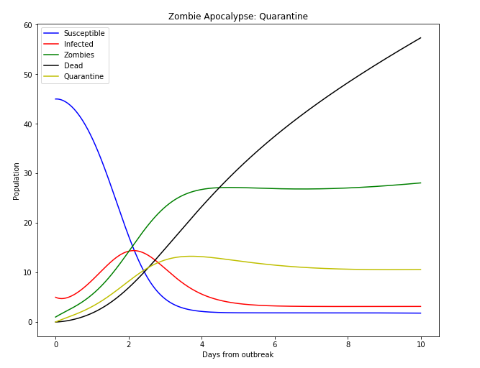
Results - Quarantine
𝑆𝑖 - Initial number of susceptible humans.
𝑍𝑖 - Initial number of zombies.
𝐼𝑖 - Initial number of infected humans.
𝐷𝑖 - Initial number of dead humans.
𝑄𝑖 - Initial number of quarantined humans.
𝑉 - Zombie to human velocity ratio.
ℎ - Increase in human population per unit time.
β - Probability of human being infected with the zombie virus per unit time.
ΔS - Probability of a human death per unit time.
Δ𝐼 - Probability of an infected human death per unit time.
ρ - Probability of infected human succumbing to zombie virus per unit time.
𝐺 - Probability of a dead human becoming a zombie per unit time.
𝑘 - Rate of infected human quarantine per unit time.
α - Probability of zombie death per unit time.
σ - Rate of zombie quarantine per unit time.
γ - Probability of human attempting to escape quarantine per unit time.
h = 0
β = 0.1
ρ = 1
α = 0.006
ΔI = 0.0
ΔS = 0.0067
G = 0.06
k = 0.6
σ = 0.2
γ = 0.7
V = 1

Slide 10
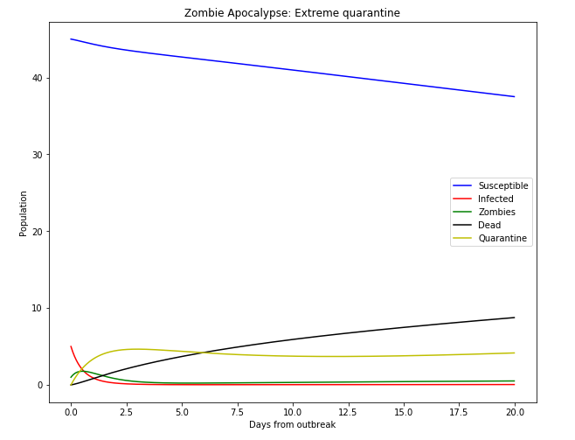
Results - Extreme Quarantine
𝑆𝑖 - Initial number of susceptible humans.
𝑍𝑖 - Initial number of zombies.
𝐼𝑖 - Initial number of infected humans.
𝐷𝑖 - Initial number of dead humans.
𝑄𝑖 - Initial number of quarantined humans.
𝑉 - Zombie to human velocity ratio.
ℎ - Increase in human population per unit time.
β - Probability of human being infected with the zombie virus per unit time.
ΔS - Probability of a human death per unit time.
Δ𝐼 - Probability of an infected human death per unit time.
ρ - Probability of infected human succumbing to zombie virus per unit time.
𝐺 - Probability of a dead human becoming a zombie per unit time.
𝑘 - Rate of infected human quarantine per unit time.
α - Probability of zombie death per unit time.
σ - Rate of zombie quarantine per unit time.
γ - Probability of human attempting to escape quarantine per unit time.
h = 0
β = 0.005
ρ = 1
α = 0.005
ΔI = 0.0
ΔS = 0.0067
G = 0.06
k = 0.9
σ = 0.9
γ = 0.1
V =1

Slide 11
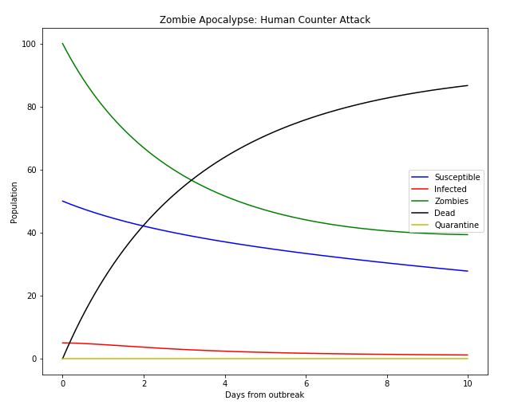
Results - Human Counter Attack
𝑆𝑖 - Initial number of susceptible humans.
𝑍𝑖 - Initial number of zombies.
𝐼𝑖 - Initial number of infected humans.
𝐷𝑖 - Initial number of dead humans.
𝑄𝑖 - Initial number of quarantined humans.
𝑉 - Zombie to human velocity ratio.
ℎ - Increase in human population per unit time.
β - Probability of human being infected with the zombie virus per unit time.
ΔS - Probability of a human death per unit time.
Δ𝐼 - Probability of an infected human death per unit time.
ρ - Probability of infected human succumbing to zombie virus per unit time.
𝐺 - Probability of a dead human becoming a zombie per unit time.
𝑘 - Rate of infected human quarantine per unit time.
α - Probability of zombie death per unit time.
σ - Rate of zombie quarantine per unit time.
γ - Probability of human attempting to escape quarantine per unit time.
h = 0
β = 0.01
ρ = 1
α = 0.006
ΔI = 0.0
ΔS = 0.005
G = 0.06
k = 0
σ = 0
γ = 0
V = 1

Slide 12
Analysis
With little response the human population is quickly eradicated by the zombie infection outbreak.
Standard quarantine does not work in defeating the zombies.
Extreme quarantine measures are necessary in order to effectively prolong the time required for full zombie apocalypse.
Zombies that travel 3x the usual speed can have their population grow ~2 times faster.
When humans mobilize against the zombies they are able to fight zombies in approximately a 2:1 ratio of zombie deaths to human deaths.

Slide 13
Questions

Slide 14
Summary
Utilizing Runge-Kutta 4 to solve for a modified SIR model we were able to depict the outcome of a zombie apocalypse under different circumstances.
Quarantine is only an effective measure against transmission of zombie infection if humans take extreme measures.
One thing that that was consistent in all graphs, except for Extreme quarantine, is that the human race faces extinction if the zombie apocalypse were to occur.
Zombie speed increased the rate of death in humans.
Humans should be able to extend the time to extinction with fast and extreme response to the zombie outbreak.

Slide 15
References
Alemi, Alexander A., et al. “You Can Run, You Can Hide: The Epidemiology and Statistical Mechanics of Zombies.” Physical Review E, vol. 92, no. 5, 2015, doi:10.1103/physreve.92.052801.
Close, James. “Archaeology of the Undead.” The Atlantic, Atlantic Media Company, 14 Sept. 2017, www.theatlantic.com/science/archive/2016/05/zombie-archaeology/483195/.
“Computational Physics.” Computational Physics – Online Resources, www-personal.umich.edu/~mejn/cp/.
History.com Editors. “Zombies.” History.com, A&E Television Networks, 13 Sept. 2017, www.history.com/topics/folklore/history-of-zombies.
Luckhurst, Roger. “Culture - Where Do Zombies Come from?” BBC, BBC, 31 Aug. 2015, www.bbc.com/culture/story/20150828-where-do-zombies-come-from.
Mendon¸ca, Jo˜ao A, et al. “Modeling Our Survival in a Zombie Apocalypse.” Arxiv, arxiv.org/pdf/1802.10443.pdf.
“Modeling a Zombie Apocalypse.” Modeling a Zombie Apocalypse - SciPy Cookbook Documentation, scipy-cookbook.readthedocs.io/items/Zombie_Apocalypse_ODEINT.html.
Shirey, Eric. “Horror Films to Watch on President's Day - Cinelinx: Movies. Games. Geek Culture.” Cinelinx, 16 Feb. 2015, www.cinelinx.com/off-beat/horror-films-to-watch-on-president-s-day/.
“The SIR Model for Spread of Disease - The Differential Equation Model.” The SIR Model for Spread of Disease - The Differential Equation Model | Mathematical Association of America, www.maa.org/press/periodicals/loci/joma/the-sir-model-for-spread-of-disease-the-differential-equation-model.
“QUARANTINE.” QUARANTINE | Sony Pictures Entertainment, www.sonypictures.com/movies/quarantine.
Byrd, Matthew, et al. “Resident Evil Movie Reboot Finds Director and Writer.” Den of Geek, 17 Dec. 2018, www.denofgeek.com/games/resident-evil-movie-reboot-release-date-cast-news/.

